Slide 1

A CLASSIFICATION SCHEMA FOR DESIGNING AUGMENTED REALITY EXPERIENCES
Shaun Bangay, Sophie McKenzie
School of Information Technology
Deakin University,
Geelong, Australia
shaun.bangay@deakin.edu.au
sophie.mckenzie@deakin.edu.au

Slide 2
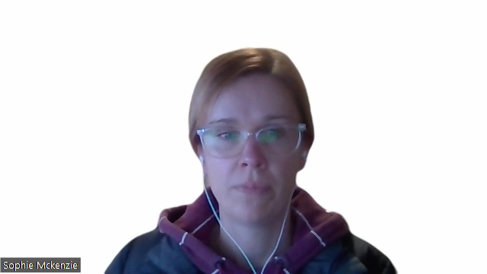
What are our design choices for AR?
Goal: This paper is to define design choices when constructing an AR interactive experience.
Solution: Present a classification schema that describes the design choices when constructing an AR interactive experience.
Notes:
The genesis of this work comes from a practical space, how to help clients discuss and explore design options and considerations for AR. What are there design choices?
Augmented reality is typically described as experiences that overlay computer-generated (virtual) content over a technology-mediated depiction of the physical world. Existing studies report on certain features of what this might look like as an interactive experience, however a comprehensive suit of design considerations has not previously been presented to help designers, developers and clients consider all options available. The goal of this paper is to define the design choices when constructing an AR interactive experience. We achieve this through presenting a classification schema that describes the design choices when constructing AR interactive experiences.

Slide 3
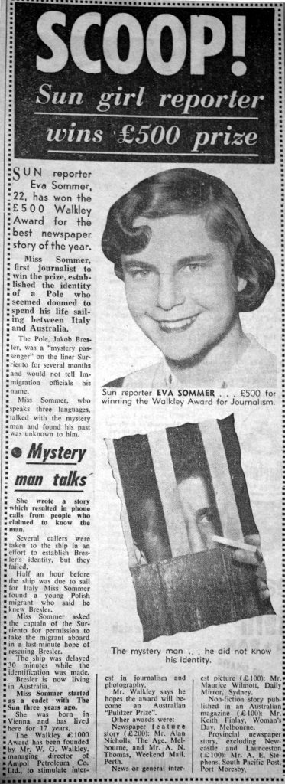
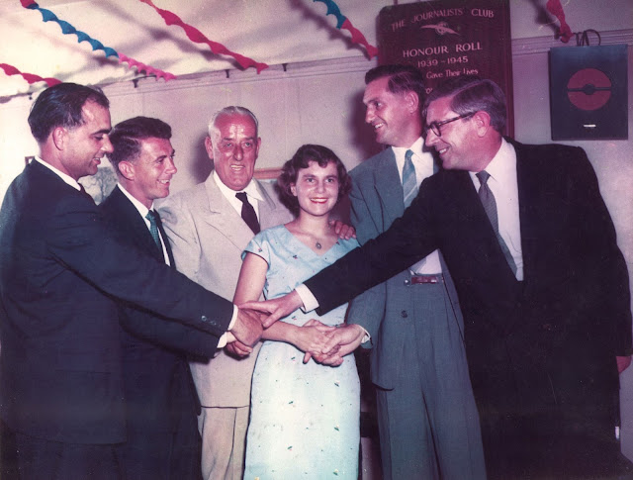

Designing Augmented Reality Experience Across Domains
Connecting audiences to Journalism, and the Walkley awards
Direct engagement with material, build trust
Degrees of interaction, view, mediate, participate
Notes:
Augmented reality can support interactive experience across a variety of domains such as education, health and entertainment.
As an example, lets look at a design scenario from journalism, where using AR has been strongly considered in regards to digitizing and creating stories in relation to the Walkley awards (which are prizes in Journalism).
Focusing in on the first Walkley award winner Eva Sommer, we see various artefacts on the slide which start to tell her story.
We are demonstrating the value of the digitized Walkley archive through creating experiences that connect people to exemplary journalistic pieces.
Build trust and confidence in journalism, and journalists, by engaging directly with the ways in which journalism adds value to society.
We can provide a detailed context to the story in this case a traumatized refugee from a world war 2 concentration camp trapped as a stowaway on ship shuttling between Italy and Australia, and unable to enter either country.

Slide 4
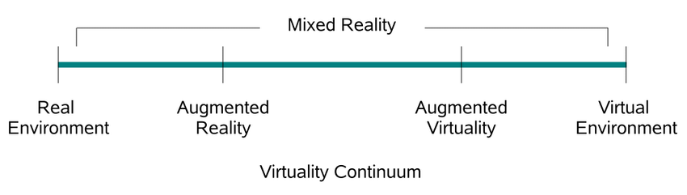
Literature Review: Classifying Realities
P. Milgram and F. Kishino, "A Taxonomy of Mixed Reality Visual Displays," IEICE Transactions on Information Systems, vol. E77-D, Dec. 1994.
AR is more than the registration of objects onto locations in the physical setting and demands consideration of the nature of the interactive experience (Aluri, 2017; R. Azuma et al., 2001; Collins et al., 2017; Skarbez et al., 2021; Steuer, 1992).
Notes:
The well-known Milgram scale defines a linear continuum of real-to -virtual environments in which AR is one part of the general area of mixed reality. Mixed reality defines a wide range of applications that situate digital information in the world by the simultaneous perception of real and virtual.
We argue in our paper and through the classification schema that AR cannot simply be defined as a single point on the virtuality continuum, and that the exact nature of the experience needs to consider more nuanced understanding of the experience, allows the user to explore a diverse experience rather than just registration of objects onto locations.
While we use AR as the primary term throughout this paper as it is often incarnated in highly varied forms, the classification schema is also able to provide greater resolving power in describing the diversity of mixed reality experiences.

Slide 5
Review Methodology
Scholarly sources and AR application case studies (selected based on peer review status) identified via Google Scholar through keywords such as ‘Augmented Reality’, ‘Augmented Experiences’, ‘Design,’ and ‘Mixed Reality’.
Initial filtering conducted: Selected papers as they were either a design classification schema or AR relevant case studies
Papers eliminated: focused on particular technology element or interaction mechanic.
Outcome: 90 papers selected that focus on AR experience design from multi-disciplinary settings
Classification: Two authors reviewed filtered papers for common themes, 26 paper grouping identified
Notes:
Google Scholar was used to identify the diverse range of existing literature relevant to the design of AR experiences, with relevant key words and phrases defined.
Google Scholar was also used as an index for open access and other journal sources, with all papers cited taken from peer-reviewed sources. This approach ensured that the literature represented a multidisciplinary view of augmented and extended reality.
Initial filtering conducted: Paper selected that inform the classification schema by either presenting relevant design classification schema themselves, or by describing AR relevant case studies suitable for categorization using the design classification schema. We found 90 relevant papers.
Initially ,papers were grouped by the paper’s authors based on the subject matter, with existing AR literature forming 26 groups.

Slide 6
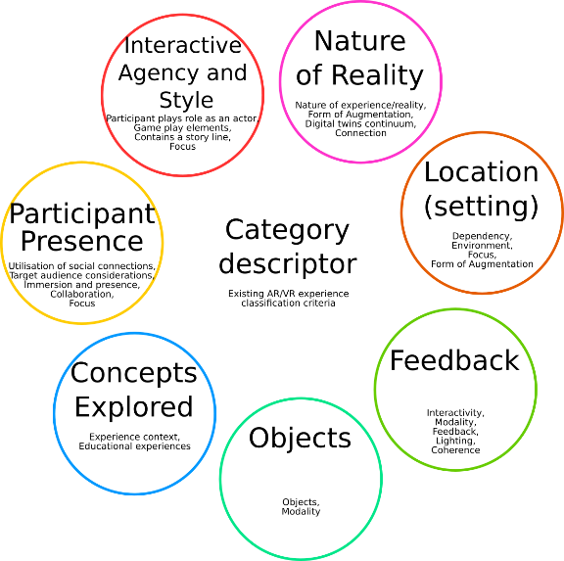
Review Outcomes
Notes:
Within 26 groups, the authors further refined through discussion to define seven dimension that describe the existing AR experience literature.
The grouping into the seven dimensions are represented with the 7 circles. Each of the 26 groups is assigned to one of the dimensions that embody that concept.
We argue that we designing an AR interactive experience, design, developers and project clients need to consider.
Nature of reality describe the form of augmentation, and it’s connection to known perspective of reality.
Location is the way in which the setting is incorporated into the experience
Feedback relates to the information cycle that is available to support the user experience
Objects are visual and audio atrefacts used to augment the experience
Concepts explored relates to the subject matter of the interactive experience
Participant presence is described as how the user of the interactive experience engage with one another
Interactive Agency and Style consider the use of performance, narrative or ludic aspects to support design.

Slide 7
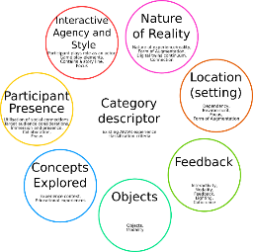
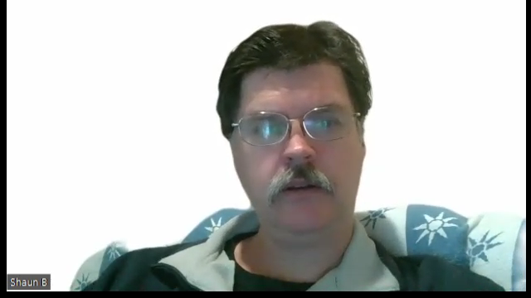
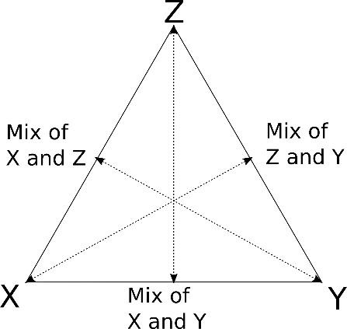
Review Scoring: Classifying Design Choice for AR
Notes:
Within each of the 7 dimensions, we identified three cornerstone characteristics. These are represented by the properties X, Y and Z in the triangle diagram. These triangles then allow an augmented reality design to be classified with respect to each of the dimensions and their corresponding cornerstone properties.
For example, an AR system that represents a lot of the use of X, a bit of Y and a little Z would be plotted close to X, partway to Y and quite far from Z. We applied this process to more than 90 examples of AR system designs reported in research literature. This analysis ensures that the classification schema is valid and can be applied in practice, and provides an opportunity to analyze AR design practices in use. It also allows the reverse mapping – any point within the triangle can be turned into an AR design, with nearby points representing examplars of appropriate practice.

Slide 8
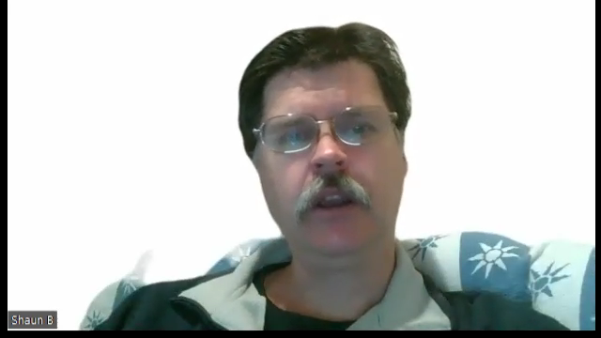
Review Scoring: Classifying Design Choice for AR
Point representing mostly X,
some Y and not much Z
Notes:
Within each of the 7 dimensions, we identified three cornerstone characteristics. These are represented by the properties X, Y and Z in the triangle diagram. These triangles then allow an augmented reality design to be classified with respect to each of the dimensions and their corresponding cornerstone properties.
For example, an AR system that represents a lot of the use of X, a bit of Y and a little Z would be plotted close to X, partway to Y and quite far from Z. We applied this process to more than 90 examples of AR system designs reported in research literature. This analysis ensures that the classification schema is valid and can be applied in practice, and provides an opportunity to analyze AR design practices in use. It also allows the reverse mapping – any point within the triangle can be turned into an AR design, with nearby points representing examplars of appropriate practice.

Slide 9
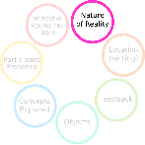

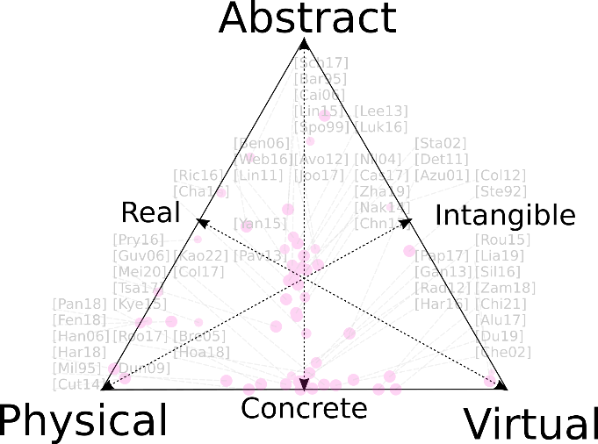
Example of Nature of Reality
Notes:
The first of the seven dimensions is described using the label “Nature of Reality”. This extends the Milgram scale, which is presented on the bottom edge of the triangle, ranging from physical reality through to virtual reality, with augmented reality systems typically falling somewhere in the middle. We’ve extended this scale by adding an Abstract corner to the triangle. The way in which an enhanced reality experience presents reality can then involve a mixture of being: mediated by the physical world (so attracted to the physical corner), mediated by a computer (so attracted to the virtual corner) or mediated through the mind of the human participant (so attracted to the abstract corner).
The nature of reality dimension classifies the complete experience and extends on the Milgram scale (Milgram et al., 1995)with its categories of physical and virtual reality, by including an orthogonal category of abstract reality that extends the computer-mediated experience with human-mediated el-ements. Any form of mediated communication can provide an experience that transports the audi-ence ( Steuer, 1992), from placing the reader in a story-like novel through to acting upon a narrative in a video game. A consideration when designing an AR experience should be what the desired experi-ence should provide in terms of the representation of reality (Chen et al.,2013 ). The literature ex-ploring existing AR experiences shows a mix between virtual and physical realities (R. T. Azuma, 1997; Collins et al., 2017; Lindgren& Moshell, 2011; Lukyanenko, 2016; Nilsen et al., 2004; Rouse et al., 2015). Providing an AR experience, as with MR, relies on the perceptually successful blending of reality and virtuality, providing a coherent set of stimuli for the participant (Collins et al., 2017), or an interweaving of experience that alternates between the real and virtual environments (Hoang& Cox, 2018 ).When defining the nature of reality, we define three vertex labels: physical as that which relates to the way in which the real world is experienced through the participant’s senses; virtual which is pro-vided through a computer-mediated experience not detectable through a participant’s own unaug-mented senses,and abstract experiences may be a combination of physical and virtual components, but rely on imagination, willing disbelief,and human mediation to consider the representation of re-ality provided (Aluri, 2017; Stapleton et al., 2002). A blend of the factors – a bstract, physical,and vir-tual – is required to define the nature of reality presented in any AR application, as shown in Figure 1.

Slide 10


Example of Nature of Reality
Read a physical newspaper and play out the story in your imagination.
Notes:
https://www.pexels.com/photo/woman-holding-the-new-york-times-newspaper-1524146/
We illustrate the use of this particular dimension of the classification schema by applying it to the Walkley journalism context. One strategy generated during brainstorming in the design session was to create an experience where the story unfolded as written up in a physical newspaper. The experience itself would be mediated by the physical world through the paper itself, but the experience would involve significant mediation through the human mind as the written word is translated into images and scenarios as it plays out in the imagination.

Slide 11
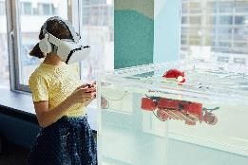

Example of Nature of Reality
Play a role in the story immersed in virtual reality
Read a physical newspaper and play out the story in your imagination.
Notes:
https://www.pexels.com/photo/woman-holding-the-new-york-times-newspaper-1524146/
https://www.pexels.com/photo/girl-using-vr-headset-testing-new-device-7869452/
An alternative suggestion, still focused on the way in which reality is manipulated, was to experience the story in virtual reality. The stowaway journey would be presented on a virtual ship using a headset and with all communication mediated through the computer. In particular communication with other participants would be degraded, to provide the experience of navigation a foreign world in a language you don’t understand. This would be plotted close to the virtual corner, with a small abstract element resulting from the mental effort to make sense of the experience.

Slide 12

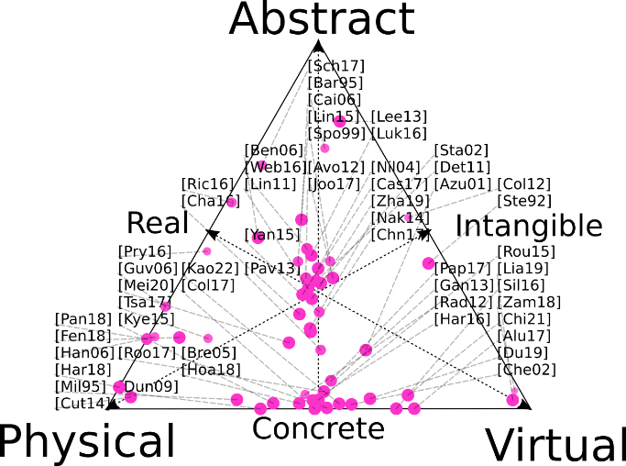
Nature of Reality
Notes:
If we review the coordinates of the experiences from research literature, we see that there are a significant number in the middle of the bottom edge. The review did focus on augmented reality experiences, so this is not unexpected. The cluster in the center does indicate that many experiences do involve the human participant in interpreting the reality presented, which is immediate value achieved by adding the abstract human mediated property to the classification. The entire area of the triangle is quite well represented and reflects the innovative designs being reported across the research literature.
The nature of reality dimension classifies the complete experience and extends on the Milgram scale (Milgram et al., 1995)with its categories of physical and virtual reality, by including an orthogonal category of abstract reality that extends the computer-mediated experience with human-mediated el-ements. Any form of mediated communication can provide an experience that transports the audi-ence ( Steuer, 1992), from placing the reader in a story-like novel through to acting upon a narrative in a video game. A consideration when designing an AR experience should be what the desired experi-ence should provide in terms of the representation of reality (Chen et al.,2013 ). The literature ex-ploring existing AR experiences shows a mix between virtual and physical realities (R. T. Azuma, 1997; Collins et al., 2017; Lindgren& Moshell, 2011; Lukyanenko, 2016; Nilsen et al., 2004; Rouse et al., 2015). Providing an AR experience, as with MR, relies on the perceptually successful blending of reality and virtuality, providing a coherent set of stimuli for the participant (Collins et al., 2017), or an interweaving of experience that alternates between the real and virtual environments (Hoang& Cox, 2018 ).When defining the nature of reality, we define three vertex labels: physical as that which relates to the way in which the real world is experienced through the participant’s senses; virtual which is pro-vided through a computer-mediated experience not detectable through a participant’s own unaug-mented senses,and abstract experiences may be a combination of physical and virtual components, but rely on imagination, willing disbelief,and human mediation to consider the representation of re-ality provided (Aluri, 2017; Stapleton et al., 2002). A blend of the factors – a bstract, physical,and vir-tual – is required to define the nature of reality presented in any AR application, as shown in Figure 1.
Citations are mapped/displayed on each dimenstion through a citation key: For example [Alu2017] is Aluri 2017, note references at the end of this presentation.
Citation is mapped only once to each dimension, but may be present on more than one dimension, and with a different score.
A purely physical reality corresponds to traditional reality within the physical world and uses elements consistent with that environment. Virtual refers to a computer-generated representation that is physically plausible but represents a world that is not present at that location at that time. Abstract refers to concepts that have non-traditional representations that may require human-mediated suspension of disbelief or invoke an imaginative process such as when reading a book. Of the minor (edge midpoint) categories, real (converse of virtual) refers to physically based elements or concepts available in the world, rather than purely virtual. Concrete (converse of abstract) defines the level of imagination required by the participant during the interactive experience. Intangible (converse of physical) reality is not physically available but can be suggested through some form of augmentation. The goals of the experience will direct the concepts included, informing expectations on participant outcomes.
What is this image saying?
Experiences and paper reviewed focus on experiences of a concrete nature, with reality intersecting with the real world.

Slide 13
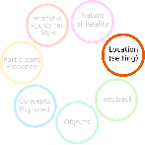
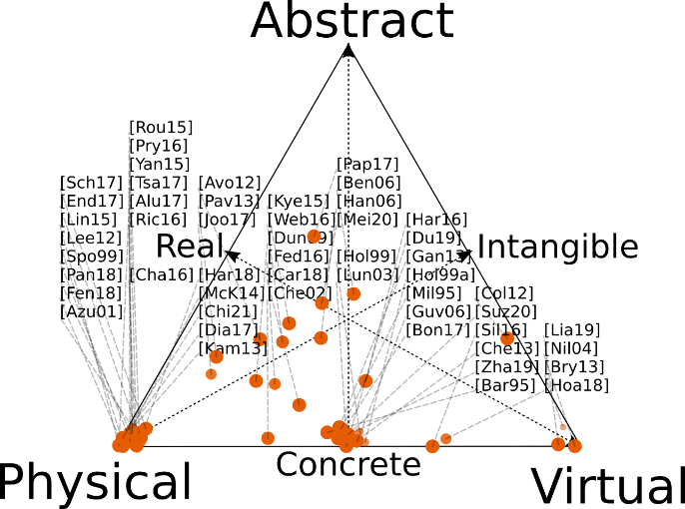
Location
Notes:
The location dimension refers specifically to the representation of place. The term ‘location’ variously relates to sensitivity to the participant’s location, to integrating the location with the experience, and to utilizing the context of a specific location. This dimension explicitly focuses on experiences that are designed to exploit the context and nature of a specific location(s) as opposed to those intended for use regardless of the situation.
Similar to the nature of reality, a blend of the factors abstract, physical, and virtual is required to define the setting, as shown in Figure 2.
Physical refers to when an application is set in the real-world location that the participant is visiting and utilizes this physical environment. Virtual settings are provided as computer-generated synthetic elements that immerse the participant in the place without needing to be physically present.
Opposing a concrete experience are those with an abstract link to the location employing imaginative or reinterpreted representations, or those that are not sensed directly.
A designer may choose to blend these dimensions but is also able to focus on just one and enrich the experience through design choices related to the other dimensions of an AR experience design.

Slide 14
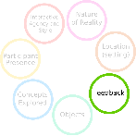
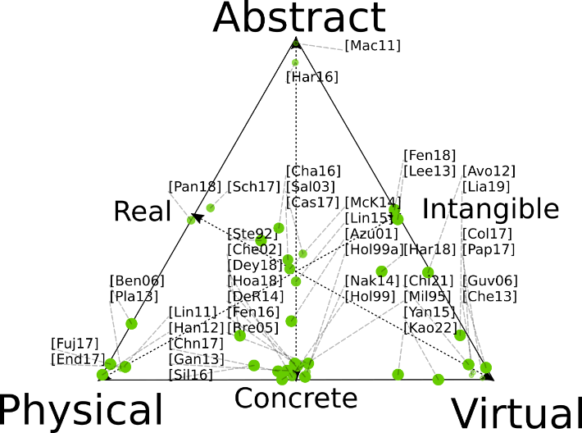
Feedback
Notes:
Feedback is classified as physical, virtual, and abstract based on the form of feedback.
Physical feedback involves physical interactions through real-world elements.
Virtual feedback is mediated through technology.
Feedback in the physical world is a response to moving around the space of action, and in the virtual world occurs through actions of interface elements or viewing the space of action through an AR view.
Abstract feedback is participant mediated such as a trigger for imagination or an emotional response. It is indirect and requires further interpretation such as inferring the behaviour of a ghost based on particular noises or of changes in personal status based on points scored.

Slide 15
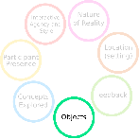
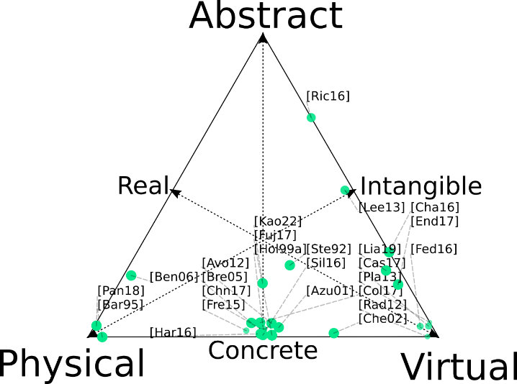
Objects
Notes:
The objects dimension specifies the nature of the discrete elements with which the participant interacts.
Objects in an AR experience include both virtual and physical items and may represent real objects, parts of an environment, or abstract elements in the experience. Abstract objects are those that do no exist from our understanding of the natural and physical world.
Examples include the virtual elements that appear on surfaces captured from the real world whereas physical objects can become tangible interactive elements by projecting content onto them.
A designer can blend any selection of objects in their application and should consciously decide on which are most appropriate to their requirements.

Slide 16
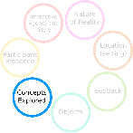
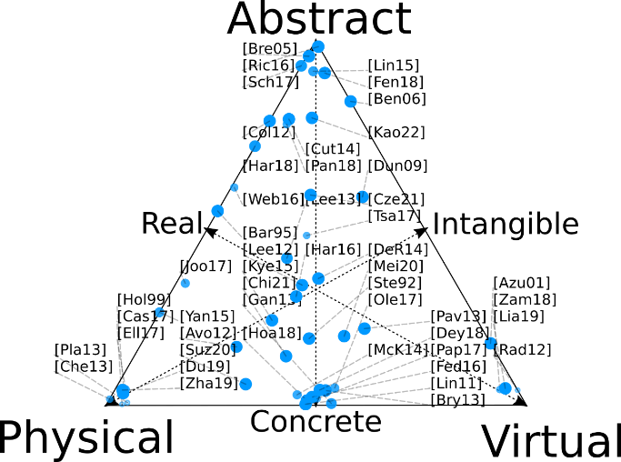
Concepts Explored
Notes:
The concepts explored dimension describes the nature of the information that the participant is engaging with through the context of the experience.
Physical concepts are those that are practical and hands-on, typically with a focus on spatial structure and relationships.
Virtual concepts convey ideas that cannot practically be represented physically, overlaying information about physical objects,
Abstract concepts are those that cannot be presented spatially such as social relationships, emotion, or abstract mathematical ideas, and may include elements of deduction or reasoning. Consequently, real concepts are physically verifiable, but not always visible or directly representable.

Slide 17
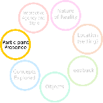
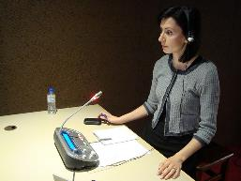
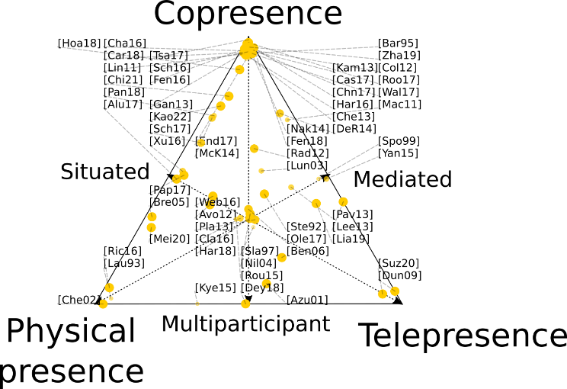
Participant Presence
Notes:
AR interactive experiences provide varying degrees of physical presence, providing physical proximity for participant interaction, as well as virtual or telepresence which is largely technology-mediated.
Physical presence occurs when the interaction is between participants in physical proximity, with telepresence occurring when it is technology-mediated usually because the participants are not co-located.
Copresence occurs when engagement is primarily with the experience, rather than with other participants who may be at the same location.
Coming back to the Walkley example, in design participant presence was considered mediated, physical and situated

Slide 18
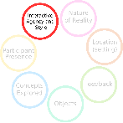
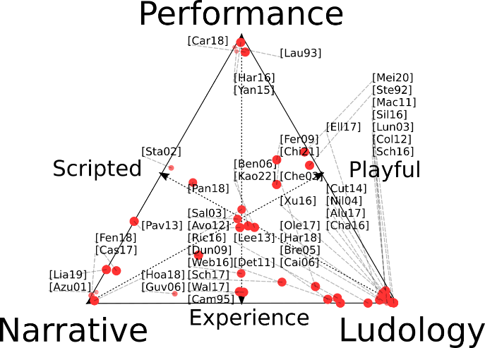

Interactive Agency and Style
Notes:
Interactive Agency and Style include narrative, ludic, and roleplaying elements.
Performance includes active and interactive elements that provide a sense of agency for the participant (such as role-playing)
The narrative represents the degree of the structured story present in the which participants can experience but have limited effect on the outcome.
Ludic elements impose particular rules defining an explicit relationship between actions and outcomes but allow participants to explore the space of possibilities within this structure.
In regards to the Walkley scenario, the AR experience could situate the user as an investigative journalist, using playful elements to engage them in a role-playing experience.

Slide 19
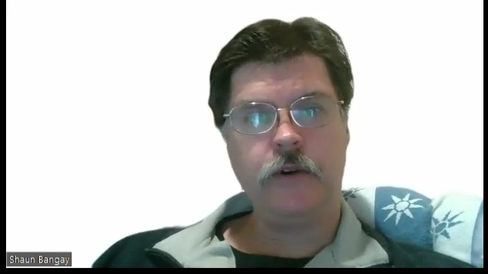
Walkley scenario example
Proposed design: A role playing experience with the stowaway immersed in a virtual ship. The journalist interviewing them via a text chat. Communication via an automatic translation system (via several foreign languages). Challenge of discovering the stowaway’s story. Find documents, visa and records as the story progresses.

Slide 20
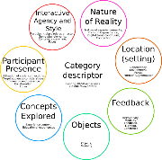
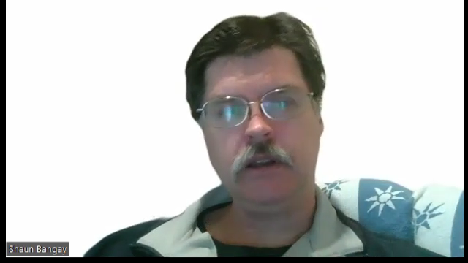
Walkley scenario example
Proposed design: A role playing experience with the stowaway immersed in a virtual ship. The journalist interviewing them via a text chat. Communication via an automatic translation system (via several foreign languages). Challenge of discovering the stowaway’s story. Find documents, visa and records as the story progresses.
Nature of reality
Location/setting
Feedback
Nature of reality
Participant presence
Interactive agency and style
Concepts explored
Objects
Interactive agency and style
Notes:
As you can see, even this fragment of the design describes functionality related to all seven dimensions of the classification scheme. This helps ensure that the experience design is comprehensive, and that all members of the design team have been effective in contributing to the richness of the experience.

Slide 21
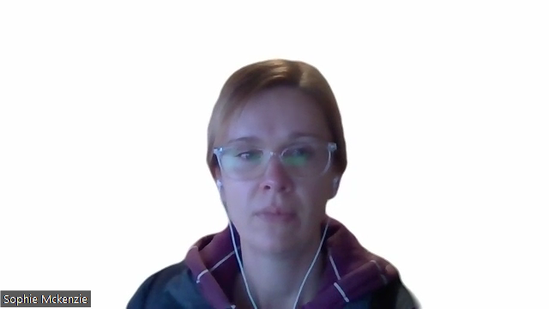
Discussion/ Conclusion
Understand design interpretation, seven dimensions
Seven dimensions summarise rich and diversity of AR/VR applications
Project clients are active designers
Notes:
In conclusion, The application of the classification schema to a broad range of AR applications has been demonstrated in producing Figures 1-7 providing explicit choices for designers that are made across the seven dimensions.
We hope the presentation today has demonstrated an approach that support design of interactive experiences for a multi-disciplinary context, including multiple stakeholder in design. The seven dimensions are not explicit, some ambiguity and cross over can be useful in design to encourage creativity, flexibility, and exchange of ideas when agreeing on an interpretation.
Our approach has the designer as an active participant, advising and challenging partners from other disciplines. In the design, its not just about getting enough information to build software but providing advice and opportunities on how the experience could/should be provided.

Slide 22

Questions?
Shaun Bangay, Sophie McKenzie
School of Information Technology
Deakin University,
Geelong, Australia
shaun.bangay@deakin.edu.au
sophie.mckenzie@deakin.edu.au

Slide 23
References
[Aluri, 2017] Aluri, A. (2017). Mobile augmented reality (mar) game as a travel guide: insights from pokemon go. Journal of Hospitality and Tourism Technology, 8(1), 55–72, https://doi.org/10.1108/ Jhtt-12-2016-0087.
[Avouris and Yiannoutsou, 2012] Avouris, N. & Yiannoutsou, N. (2012). A review of mobile location-based games for learning across physical and virtual spaces. Journal of Universal Computer Science, 18(15), 2120–2142, https://doi.org/10.3217/jucs-018-15-2120.
[Azuma et al., 2001] Azuma, R., Baillot, Y., Behringer, R., Feiner, S., Julier, S., & MacIntyre, B. (2001).
Recent advances in augmented reality. IEEE Computer Graphics and Applications, 21(6), 34–47, https: //doi.org/10.1109/38.963459.
[Azuma, 1997] Azuma, R. T. (1997). A survey of augmented reality. Presence: Teleoper. Virtual Environ., 6(4), 355–385, https://doi.org/10.1162/pres.1997.6.4.355.
[Barfield et al., 1995] Barfield, W., Rosenberg, C., & Lotens, W. A. (1995). Virtual Environments and Advanced Interface Design, chapter Augmented-reality Displays, (pp. 542–575). Oxford University Press, Inc.: New York, NY, USA.
[Benford et al., 2006] Benford, S., Crabtree, A., Reeves, S., Sheridan, J., Dix, A., Flintham, M., & Drozd, A. (2006). The frame of the game: Blurring the boundary between fiction and reality in mobile experiences.
ACM Conference on Human Factors in Computing Systems (CHI), (pp. 427–436)., https://doi.org/10. 1145/1124772.1124836.
[Bonfert et al., 2017] Bonfert, M., Lehne, I., Morawe, R., Cahnbley, M., Zachmann, G., & Schoning, J.
(2017). Augmented invaders: A mixed reality multiplayer outdoor game. In Proceedings of the 23rd ACM Symposium on Virtual Reality Software and Technology – VRST ’17, VRST ’17 (pp. 7–8). New York, USA: https://doi.org/10.1145/3139131.3141208.
[Brederode et al., 2005] Brederode, B., Markopoulos, P., Gielen, M., Vermeeren, A., & de Ridder, H. (2005). powerball: the design of a novel mixed-reality game for children with mixed abilities. Interaction Design and Children, (pp. 32–39)., https://doi.org/10.1145/1109540.1109545.
[Brynjolfsson et al., 2013] Brynjolfsson, E., Hu, Y. J., & Rahman, M. S. (2013). Competing in the age of omnichannel retailing. MITSloan: Managament Review Summer 2013, 54(4).
[Caillois, 2006] Caillois, R. (2006). The Game Design Reader: A Rules of Play Anthology, chapter The Definition of Play, The Classification of Games, (pp. 122–155). MIT Press: Cambridge, Massachusetts,
[Cameron, 1995] Cameron, A. (1995). Dissimulations: illusions of interactivity. Millenium Film Journal, 28, 33–47.
[Carlson et al., 2018] Carlson, K., Sun, P., Cuykendall, S., & Lantin, M. (2018). Beyond the here and now: Exploring threaded presence in mediated, improvised performance. Presence: Teleoperators and Virtual Environments, 26(2), 97–110, https://doi.org/10.1162/PRES_a_00288.
[Castaneda et al., 2018] Castaneda, L. M., Bindman, S. W., Cechony, A., & Sidhu, M. (2018). The disconnect between real and virtually real worlds: The challenges of using vr with adolescents. Presence: Teleoperators and Virtual Environments, 26, 453, https://doi.org/10.1162/PRES_a_00310.
[Chatzidimitris et al., 2016] Chatzidimitris, T., Gavalas, D., & Michael, D. (2016). Soundpacman: Audio augmented reality in location-based games. In 18th Mediterranean Electrotechnical Conference: Intelligent and Efficient Technologies and Services for the Citizen, MELECON 2016 Cyprus: https://doi.org/10. 1109/Melcon.2016.7495414.
[Chen et al., 2013] Chen, L., Chen, G., & Benford, S. (2013). Your way your missions: A location-aware pervasive game exploiting the routes of players. International Journal of Human-Computer Interaction, 29(2), 110–128, https://doi.org/10.1080/10447318.2012.694790.
[Cheng et al., 2019] Cheng, L.-P., Ofek, E., Holz, C., & Wilson, A. D. (2019). VRoamer: Generating on-the-fly VR experiences while walking inside large, unknown real-world building environments. In 2019 IEEE Conference on Virtual Reality and 3D User Interfaces (VR) (pp. 359–366).: https://doi.org/10. 1109/vr.2019.8798074.
[Cheok et al., 2002] Cheok, A. D., Yang, X., Ying, Z. Z., Billinghurst, M., & Kato, H. (2002). Touch-space: Mixed reality game space based on ubiquitous, tangible, and social computing. Personal and Ubiquitous Computing, 6, 430–442, https://doi.org/10.1007/s007790200047.
[Chiam et al., 2021] Chiam, B. S. W., Leung, I. M. W., Devilly, O. Z., Ow, C. Y. D., Guan, F. Y., & Tan, B. L. (2021). Novel augmented reality enhanced solution towards vocational training for people with mental disabilities. In 2021 IEEE International Symposium on Mixed and Augmented Reality Adjunct (ISMAR-Adjunct): https://doi.org/10.1109/ismar-adjunct54149.2021.00047.
[Ch’ng et al., 2017] Ch’ng, E., Harrison, D., & Moore, S. (2017). Shift-life interactive art: Mixed-reality artificial ecosystem simulation. Presence: Teleoperators and Virtual Environments, 26(2), 157–181, https://doi.org/10.1162/PRES_a_00291.
[Clark and Clark, 2016] Clark, A. M. & Clark, M. T. G. (2016). Pokemon go and research: Qualitative, mixed methods research, and the supercomplexity of interventions. International Journal of Qualitative Methods, 15(1), https://doi.org/10.1177/1609406916667765.
[Cole et al., 2012] Cole, S. W., Yoo, D. J., & Knutson, B. (2012). Interactivity and reward-related neural activation during a serious videogame. Plos One, 7(3), e33909, https://doi.org/10.1371/journal.
pone.0033909.

Slide 24
References
[Collins et al., 2017] Collins, J., Regenbrecht, H., & Langlotz, T. (2017). Visual coherence in mixed reality: A systematic enquiry. Presence: Teleoperators and Virtual Environments, 26(1), 16–41, https://doi. org/10.1162/PRES_a_00284.
[Cutter et al., 2014] Cutter, C. J., et al. (2014). A pilot trial of a videogame-based exercise program for methadone maintained patients. Journal of Substance Abuse Treatment, 47(4), 299–305, https://doi. org/10.1016/j.jsat.2014.05.007.
[Czerkawski and Berti, 2021] Czerkawski, B. & Berti, M. (2021). Learning experience design for augmented reality. Research in Learning Technology, 29, https://doi.org/10.25304/rlt.v29.2429.
[de Ribaupierre et al., 2014] de Ribaupierre, S., Kapralos, B., Haji, F., Stroulia, E., Dubrowski, A., & Eagleson, R. (2014). Virtual, Augmented Reality and Serious Games for Healthcare 1, chapter Healthcare Training Enhancement Through Virtual Reality and Serious Games, (pp. 9–27). Springer Berlin Heidelberg: Berlin, Heidelberg.
[Deterding et al., 2011] Deterding, S., Dixon, D., Khaled, R., & Nacke, L. (2011). From game design elements to gamefulness: defining ‘‘gamification’’. In Proceedings of the 15th International Academic MindTrek Conference: Envisioning Future Media Environments (pp. 9–15). Tampere, Finland: https: //doi.org/10.1145/2181037.2181040.
[Dey et al., 2018] Dey, A., Billinghurst, M., Lindeman, R. W., & Swan, J. E. (2018). A systematic review of 10 years of augmented reality usability studies: 2005 to 2014. Frontiers in Robotics and AI, 5, 37, https://doi.org/10.3389/frobt.2018.00037.
[Diaconu et al., 2018] Diaconu, R., Deng, J., Bacon, J., & Singh, J. (2018). Comflux: External composition and adaptation of pervasive applications. In 2018 IEEE International Conference on Pervasive Computing and Communications Workshops (PerCom Workshops) (pp. 427–429). ArXiv: https://doi.org/10. 1109/PERCOMW.2018.8480214.
[Du et al., 2019] Du, R., Li, D., & Varshney, A. (2019). Interactive fusion of 360° images for a mirrored world. In 2019 IEEE Conference on Virtual Reality and 3D User Interfaces (VR) https://doi.org/10. 1109/Vr.2019.8798187.
[Dunleavy et al., 2009] Dunleavy, M., Dede, C., & Mitchell, R. (2009). Affordances and limitations of immersive participatory augmented reality simulations for teaching and learning. Journal of Science Education and Technology, 18, 7–22, https://doi.org/10.1007/s10956-008-9119-1.
[Ellmers et al., 2017] Ellmers, T. J., Young, W. R., & Paraskevopoulos, I. T. (2017). Integrating fall-risk assessments within a simple balance exergame. In 2017 9th International Conference on Virtual Worlds and Games for Serious Applications (VS-Games) https://doi.org/10.1109/Vs-Games.2017.8056608.
[Endsley et al., 2017] Endsley, T. C., Sprehn, K. A., Brill, R. M., Ryan, K. J., Vincent, E. C., & Martin, J. M. (2017). Augmented reality design heuristics: Designing for dynamic interactions. In Proceedings of the Human Factors and Ergonomics Society Annual Meeting, volume 61 https://doi.org/10.1177/ 1541931213602007.
[Fedorov et al., 2016] Fedorov, R., Frajberg, D., & Fraternali, P. (2016). A framework for outdoor mobile augmented reality and its application to mountain peak detection. In L. T. De Paolis & Mongelli (Eds.), Augmented Reality, Virtual Reality, and Computer Graphics (pp. 281–301).: https://doi.org/10. 1007/978-3-319-40621-3.
[Fenu and Pittarello, 2018] Fenu, C. & Pittarello, F. (2018). Svevo tour: The design and the experimentation of an augmented reality application for engaging visitors of a literary museum. International Journal of Human Computer Studies, https://doi.org/10.1016/j.ijhcs.2018.01.009.
[Fernandez-Cervantes et al., 2016] Fernandez-Cervantes, V., Stroulia, E., & Hunter, B. (2016). A grammarbased framework for rehabilitation exergames. Lecture Notes in Computer Science (including subseries Lecture Notes in Artificial Intelligence and Lecture Notes in Bioinformatics), 9926 Lncs, 38–50, https: //doi.org/10.1007/978-3-319-46100-7_4.
[Fernandez-Vara, 2009] Fernandez-Vara, C. (2009). Play’s the thing: A framework to study videogames as performance. In DiGRA ’09 – Proceedings of the 2009 DiGRA International Conference: Breaking New Ground: Innovation in Games, Play, Practice and Theory:
[Freschi et al., 2015] Freschi, C., Parrini, S., Dinelli, N., Ferrari, M., & Ferrari, V. (2015). Hybrid simulation using mixed reality for interventional ultrasound imaging training. International Journal of Computer
Assisted Radiology and Surgery, 10(7), 1109–1115, https://doi.org/10.1007/s11548-014-1113-x.
[Fujinawa et al., 2017] Fujinawa, E., Yoshida, S., Koyama, Y., Narumi, T., Tanikawa, T., & Hirose, M. (2017). Computational design of hand-held vr controllers using haptic shape illusion. Proceedings of the 23rd ACM Symposium on Virtual Reality Software and Technology – VRST ’17, (pp. 1–10)., https: //doi.org/10.1145/3139131.3139160.
[Ganapathy, 2013] Ganapathy, S. (2013). Human Factors in Augmented Reality Environments, chapter Design Guidelines for Mobile Augmented Reality: User Experience, (pp. 165–180). Springer New York: New York, NY.
[Guven, 2006] Guven, S. (2006). Authoring and Presenting Situated Media in Augmented and Virtual Reality. PhD thesis, New York, NY, USA.
[Hajdu Barat, 2010] Hajdu Barat, A. (2010). From paradigms of cognition and perception to phenomenon. Advances in Knowledge Organization, 12, 43–49.
[Hansen, 2012] Hansen, M. B. N. (2012). Bodies in Code: Interfaces with Digital Media. New York: Routledge.
[Harley et al., 2016] Harley, J. M., Poitras, E. G., Jarrell, A., Duffy, M. C., & Lajoie, S. P. (2016). Comparing virtual and location-based augmented reality mobile learning: emotions and learning outcomes. Educational Technology Research and Development, 64, 359–388, https://doi.org/10.1007/ s11423-015-9420-7.
[Harris, 2018] Harris, M. A. (2018). Beat the street: A pilot evaluation of a community-wide gamificationbased physical activity intervention. Games for Health, 7(3), 208–212, https://doi.org/10.1089/ g4h.2017.0179.

Slide 25
References
[Hoang and Cox, 2018] Hoang, T. N. & Cox, T. N. (2018). Alternating reality: An interweaving narrative of physical and virtual cultural exhibitions. Presence: Teleoperators and Virtual Environments, 26(4), 402–419, https://doi.org/10.1162/PRES_a_00307.
[Hollerer et al., 1999a] Hollerer, T., Feiner, S., & Pavlik, J. (1999a). Situated documentaries: embedding multimedia presentations in the real world. In Digest of Papers. Third International Symposium on Wearable Computers, https://doi.org/10.1109/Iswc.1999.806664.
[Hollerer et al., 1999b] Hollerer, T., Feiner, S., Terauchi, T., Rashid, G., & Hallaway, D. (1999b). Exploring mars: developing indoor and outdoor user interfaces to a mobile augmented reality system. Computers & Graphics, 23(6), 779–785, https://doi.org/10.1016/S0097-8493(99)00103-X.
[International Society for Presence Research, 2000] International Society for Presence Research (2000). The concept of presence: Explication statement. Retrieved 1/8/2020 from https://smcsites.com/ispr/.
[Joo-Nagata et al., 2017] Joo-Nagata, J., Abad, F. M., Giner, J. G.-B., & Garcia-Pesalvo, F. J. (2017). Augmented reality and pedestrian navigation through its implementation in m-learning and e-learning: Evaluation of an educational program in chile. Computers & Education, 111, 1–17, https://doi.org/10. 1016/j.compedu.2017.04.003.
[Kamarainen et al., 2013] Kamarainen, A. M., Metcalf, S., Grotzer, T., Browne, A., Mazzuca, D., Tutwiler, M. S., & Dede, C. (2013). Ecomobile: Integrating augmented reality and probeware with environmental education field trips. Computers and Education, 68, https://doi.org/10.1016/j.compedu.2013.02. 018.
[Kao and Ruan, 2022] Kao, G. Y.-M. & Ruan, C.-A. (2022). Designing and evaluating a high interactive augmented reality system for programming learning. Computers in Human Behavior, (pp. 107245)., https://doi.org/10.1016/j.chb.2022.107245.
[Kysela and Storkova, 2015] Kysela, J. & Storkova, P. (2015). Using augmented reality as a medium for teaching history and tourism. Procedia – Social and Behavioral Sciences, 174, 926–931, https://doi.
org/10.1016/j.sbspro.2015.01.713.
[Laurel, 2013] Laurel, B. (2013). Computers as Theatre. Reading, MA: Addison-Wesley Publishing Company.
[Lee et al., 2013] Lee, J. J., Ceyhan, P., Jordan-Cooley, W., & Sung, W. (2013). Greenify: A real-world action game for climate change education. Simulation and Gaming, 44, 349–365, https://doi.org/10.1177/ 1046878112470539.
[Lee, 2012] Lee, K. (2012). Augmented reality in education and training. TechTrends; Washington, 56(2), 13–21, https://doi.org/http://dx.doi.org.ezproxy-b.deakin.edu.au/10.1007/ s11528-012-0559-3.
[Lee et al., 2021] Lee, L.-H., et al. (2021). All one needs to know about metaverse: A complete survey on technological singularity, virtual ecosystem, and research agenda.
[Liao et al., 2019] Liao, M., Sunq, C., Wang, H., & Lin, W. (2019). Virtual classmates: Embodying historical learners’ messages as learning companions in a vr classroom through comment mapping. In 2019 IEEE Conference on Virtual Reality and 3D User Interfaces (VR) https://doi.org/10.1109/Vr.2019.8797708.
[Lin and Chen, 2015] Lin, H.-F. & Chen, C.-H. (2015). Design and application of augmented reality queryanswering system in mobile phone information navigation. Expert Systems with Applications, 42(2), 810–820, https://doi.org/10.1016/j.eswa.2014.07.050.
[Lindgren and Moshell, 2011] Lindgren, R. & Moshell, J. M. (2011). Supporting children’s learning with body-based metaphors in a mixed reality environment. In Proceedings of the 10th International Conference on Interaction Design and Children (pp. 177–180). Ann Arbor, Michigan: https://doi.org/10.1145/ 1999030.1999055.
[Lukyanenko, 2016] Lukyanenko, R. (2016). Information quality research challenge: Information quality in the age of ubiquitous digital intermediation. J. Data and Information Quality, 7(1-2), 1–3, https: //doi.org/10.1145/2856038.
[Lundgren and Bjork, 2003] Lundgren, S. & Bjork, S. (2003). Game mechanics: Describing computeraugmented games in terms of interaction. In Proceedings of Technologies for Interactive Digital Storytelling and Entertainment (TIDSE 2003) https://doi.org/10.1057/jors.1984.31.
[Macvean, 2011] Macvean, A. P. (2011). Task-involved versus ego-involved: Motivating children to exercise in a pervasive exergame. In 2011 IEEE International Conference on Pervasive Computing and Communications Workshops (PERCOM Workshops), https://doi.org/10.1109/Percomw.2011.5766922.
[Mann et al., 2018] Mann, S., Furness, T., Yuan, Y., Iorio, J., & Wang, Z. (2018). All reality: Virtual, augmented, mixed (x), mediated (x,y), and multimediated reality.
[McKenzie et al., 2014] McKenzie, S., Bangay, S., Barnett, L. M., Ridgers, N. D., & Salmon, J. (2014). Design elements and feasibility of an organized multiplayer mobile active videogame for primary schoolaged children. Games for Health Journal, 3, 379–387, https://doi.org/10.1089/g4h.2013.0097.
[Meier et al., 2020] Meier, C., Saorín, J. L., de León, A. B., & Cobos, A. G. (2020). Using the roblox video game engine for creating virtual tours and learning about the sculptural heritage. International Journal of Emerging Technologies in Learning (iJET), 15(20), 268, https://doi.org/10.3991/ijet.v15i20. 16535.
[Milgram et al., 1995] Milgram, P., Takemura, H., Utsumi, A., & Kishino, F. (1995). Augmented reality: a class of displays on the reality-virtuality continuum. In Proc. SPIE 2351, Telemanipulator and Telepresence Technologies, volume 2351 https://doi.org/10.1117/12.197321.
[Nakevska et al., 2014] Nakevska, M., van der Sanden, A., Funk, M., Hu, J., & Rauterberg, M. (2014). Interactive storytelling in a mixed reality environment: The effects of interactivity on user experiences. In Y. Pisan & Sgouros (Eds.), Entertainment Computing – ICEC 2014, volume 8770 (pp. 52–59).:

Slide 26
References
[Nilsen et al., 2004] Nilsen, T., Linton, S., & Looser, J. (2004). Motivations for augmented reality gaming. In Fuse 04, New Zealand Game Developers Conference
[Normand et al., 2012] Normand, J.-M., Servières, M., & Moreau, G. (2012). A new typology of augmented reality applications. In AH ’12: Proceedings of the 3rd Augmented Human International Conference: https://doi.org/10.1145/2160125.2160143.
[Oleksy and Wnuk, 2017] Oleksy, T. & Wnuk, A. (2017). Catch them all and increase your place attachment! the role of location-based augmented reality games in changing people – place relations. Computers in Human Behavior, 76, 3–8, https://doi.org/10.1016/j.chb.2017.06.008.
[Pang et al., 2018] Pang, W.-C., Wong, C.-Y., & Seet, G. (2018). Exploring the use of robots for museum settings and for learning heritage languages and cultures at the chinese heritage centre. Presence: Teleoperators and Virtual Environments, 26(4), 420–435, https://doi.org/10.1162/PRES_a_00306.
[Papathanasiou-Zuhrt et al., 2017] Papathanasiou-Zuhrt, D., Weiss-Ibanez, D. F., & Di Russo, A. (2017). The gamification of heritage in the unesco enlisted medieval town of rhodes. CEUR Workshop Proceedings, 1857, 60–70.
[Pavlik and Bridges, 2013] Pavlik, J. V. & Bridges, F. (2013). The emergence of augmented reality (ar) as a storytelling medium in journalism. Journalism & Communication Monographs, 15(1), 4–59, https: //doi.org/10.1177/1522637912470819.
[Planinc et al., 2013] Planinc, R., Nake, I., & Kampel, M. (2013). Exergame design guidelines for enhancing elderly’s physical and social activities. In AMBIENT 2013: The Third International Conference on Ambient Computing, Applications, Services and Technologies (pp. 58–64). Portugal:
[Pryss et al., 2016] Pryss, R., Geiger, P., Schickler, M., Schobel, J., & Reichert, M. (2016). Advanced algorithms for location-based smart mobile augmented reality applications. Procedia Computer Science, 94, 97–104, https://doi.org/10.1016/j.procs.2016.08.017.
[Radu, 2012] Radu, I. (2012). Why should my students use ar? a comparative review of the educational impacts of augmented-reality. In 2012 IEEE International Symposium on Mixed and Augmented Reality (ISMAR) https://doi.org/10.1109/Ismar.2012.6402590.
[Richardson, 2016] Richardson, D. (2016). Exploring the potential of a location based augmented reality game for language learning. International Journal of Game-Based Learning, 6, 34–49, https://doi. org/10.4018/Ijgbl.2016070103.
[Roo and Hachet, 2017] Roo, J. S. & Hachet, M. (2017). One reality: Augmenting how the physical world is experienced by combining multiple mixed reality modalities. Proceedings of the 30th Annual ACM Symposium on User Interface Software and Technology – UIST ’17, (pp. 787–795)., https://doi.org/10.1145/3126594.3126638.
[Rouse et al., 2015] Rouse, R., Engberg, M., JafariNaimi, N., & Bolter, J. D. (2015). Mrx: an interdisciplinary framework for mixed reality experience design and criticism. Digital Creativity, 26, 175–181, https: //doi.org/10.1080/14626268.2015.1100123.
[Salen and Zimmerman, 2004] Salen, K. & Zimmerman, E. (2004). Rules of Play: Game Design Fundamentals. MIT Press.
[Schmalstieg and Hollerer, 2016] Schmalstieg, D. & Hollerer, T. (2016). Augmented Reality: Principles and Practice. Addison-Wesley usability and HCI series. Addison-Wesley.
[Schneider et al., 2017] Schneider, J., Schaal, S., & Schlieder, C. (2017). Geogames in education for sustainable development: Transferring a simulation game in outdoor settings.
[Schoneveld et al., 2016] Schoneveld, E. A., Malmberg, M., Lichtwarck-Aschoff, A., Verheijen, G. P., Engels, R. C. M. E., & Granic, I. (2016). A neurofeedback video game (mindlight) to prevent anxiety in children: A randomized controlled trial. Computers in Human Behavior, 63, 321–333, https://doi.org/10.1016/ j.chb.2016.05.005.
[Silva et al., 2016] Silva, A. R., Clua, E., Valente, L., & Feijo, B. (2016). First steps towards live-action virtual reality games. SBC Journal on Interactive Systems, 7(1), 3–16.
[Skarbez et al., 2021] Skarbez, R., Smith, M., & Whitton, M. C. (2021). Revisiting Milgram and Kishino's reality-virtuality continuum. Frontiers in Virtual Reality, 2, https://doi.org/10.3389/frvir.2021. 647997.
[Slater and Wilbur, 1997] Slater, M. & Wilbur, S. (1997). A framework for immersive virtual environments five: Speculations on the role of presence in virtual environments. Presence: Teleoper. Virtual Environ., 6(6), 603–616, https://doi.org/10.1162/pres.1997.6.6.603.
[Speicher et al., 2019] Speicher, M., Hall, B. D., & Nebeling, M. (2019). What is mixed reality? In CHI ’19: Proceedings of the 2019 CHI Conference on Human Factors in Computing Systems: https: //doi.org/10.1145/3290605.3300767.
[Speiginer and Maclntyre, 2018] Speiginer, G. & Maclntyre, B. (2018). Rethinking reality: A layered model of reality for immersive systems. In IEEE International Symposium on Mixed and Augmented Reality Adjunct: https://doi.org/10.1109/ismar-adjunct.2018.00097.
[Spohrer, 1999] Spohrer, J. C. (1999). Information in places. IBM Systems Journal, 38(4), 602–628, https: //doi.org/10.1147/sj.384.0602.
[Stapleton et al., 2002] Stapleton, C., Hughes, C., & Moshell, J. M. (2002). Mixed reality and the interactive imagination: Adding the art to the science and technology of mixed reality for training, education and entertainment introduction: Putting the stimulation in simulation. First Swedish-American Workshop on Modeling and Simulation (SAWMAS), (pp. 30–31).
[Steuer, 1992] Steuer, J. (1992). Defining virtual reality: Dimensions determining telepresence. Journal of Communication, 42(4), 73–93, https://doi.org/10.1111/j.1460-2466.1992.tb00812.x.
[Suzuki et al., 2020] Suzuki, S., et al. (2020). Virtual experiments in metaverse and their applications to collaborative projects: The framework and its significance. Procedia Computer Science, 176, 2125–2132, https://doi.org/10.1016/j.procs.2020.09.249.

Slide 27
References
[Tsai et al., 2017] Tsai, T.-H., Shen, C.-Y., Lin, Z.-S., Liu, H.-R., & Chiou, W.-K. (2017). Exploring locationbased augmented reality experience in museums. In M. Antona & Stephanidis (Eds.), Universal Access in Human–Computer Interaction. Designing Novel Interactions (pp. 199–209).: https://doi.org/10. 1007/978-3-319-58703-5_15.
[Van Krevelen and Poelman, 2010] Van Krevelen, D. W. F. & Poelman, R. (2010). A survey of augmented reality technologies, applications and limitations. International journal of virtual reality, 9(2), 1.
[Walk et al., 2017] Walk, W., Gorlich, D., & Barrett, M. (2017). Game Dynamics: Best Practices in Procedural and Dynamic Game Content Generation, chapter Design, Dynamics, Experience (DDE): An Advancement of the MDA Framework for Game Design, (pp. 27–45). Springer International Publishing.
[Weber, 2016] Weber, J. (2016). Designing Engaging Experiences with Location-Based Augmented Reality Games for Urban Tourism Environments. PhD thesis.
[Xu et al., 2016] Xu, F., Tian, F., Buhalis, D., Weber, J., & Zhang, H. (2016). Tourists as mobile gamers:
Gamification for tourism marketing. Journal of Travel and Tourism Marketing, 33, 1124–1142, https: //doi.org/10.1080/10548408.2015.1093999.
[Yan et al., 2015] Yan, S., Ding, G., Guan, Z., Sun, N., Li, H., & Zhang, L. (2015). Outsideme: Augmenting dancer’s external self-image by using a mixed reality system. In Proceedings of the 33rd Annual ACM Conference Extended Abstracts on Human Factors in Computing Systems (pp. 965–970). Seoul, Republic of Korea: https://doi.org/10.1145/2702613.2732759.
[Zamora-Musa et al., 2018] Zamora-Musa, R., Velez, J., & Paez-Logreira, H. (2018). Evaluating learnability in a 3d heritage tour. Presence: Teleoperators and Virtual Environments, 26(4), 366–377, https://doi. org/10.1162/PRES_a_00305.
[Zhao and Klippelt, 2019] Zhao, J. & Klippelt, A. (2019). Scale – unexplored opportunities for immersive technologies in place-based learning. In 2019 IEEE Conference on Virtual Reality and 3D User Interfaces (VR) https://doi.org/10.1109/Vr.2019.8797867.

